Slide 1
Micronutrient nutrition and food fortification activities in China
Chen Chunming
Chinese Center for Disease Control and Prevention
International Life Science Institute Focal Point in China
Jan. 2011

Slide 2
In the past ten years, the nutrition status of Chinese population has been dramatically improved in terms of energy and protein adequacy and general dietary pattern.
But micronutrient deficiency is still a public health issue to be addressed, because of the plant food –dominant diet.

Slide 3
I. Current micronutrient nutritional status in China

Slide 4
(1) Iodine
Successfully controlled by mandatory salt iodization since 1993 –
The challenge will be program persistency
Indicators | 1995 | 1997 | 1999 | 2002 | 2005
Coverage of households consumed iodized salt (%) | 39.9 | 69.0 | 80.6 | 88.8 | 90.2
Median of urinary I₂ In children aged 8 -10 (μg/L) | 164.8 | 330.2 | 306.0 | 241.2 | 246.3
Goiter rate in children aged 8 -10 (%) | 20.4 | 10.9 | 8.8 | 5.8 | 5.0%
Source: National IDD Surveillance (MOH)

Slide 5
(2) Iron
■ Dietary intake of iron
In 2002— 23mg/reference man

Slide 6
Dietary intake (mg/d) and source of iron in Chinese diet
 | Big cities | M/S cities | Rural I | Rural II | Rural III | Rural IV
Total intake | 24.5 | 23.5 | 23.5 | 22.6 | 24 | 22.8
Food source of iron in diet (% of total intake)
Cereals | 32.2 | 41.2 | 43.6 | 54.4 | 61.6 | 53.3
Soybean | 7 | 5.6 | 6.1 | 5.9 | 4 | 7.3
Vegetables | 16.5 | 13.6 | 15.8 | 15.2 | 11.5 | 12.6
Potato | 1.1 | 1.5 | 1.8 | 2 | 2.4 | 3.2
Meat & fish | 13.3 | 12.2 | 10.7 | 6.9 | 2.9 | 8.7
Source: 2002 Nationwide Nutrition and Health Survey

Slide 7
Calculation of the intake of absorbed iron of Chinese
Dietary intake of iron in 2002—
23mg/reference man
Assumed absorption rate of iron in Chinese diet ~4%
Estimated Absorbed iron- 0.92mg
76% of requirement of adult man
54% of requirement of adult women
40% of requirement of 15-17yr adolescent girls (Actual intake: 20mg )

Slide 8
Anemia prevalence of population in 2002
 | Urban | Rural | Nat’l
Male | 13.4 | 16.7 | 15.8
Female | 21.5 | 24.0 | 23.3
By age groups
Children 6-11mon. | 40.6 | 37.5 | 38.3
12-23mon. | 29.2 | 28.9 | 29.0
Women 18-44yr | 23.7 | 27.2
Adult >60yr | 19.6 | 31.6 | 28.8
Pregnant women | 25.3 | 30.4 | 28.9
Source: 2002 Nationwide Nutrition and Health Status Survey, Report 1

Slide 9
Minor/no reduction of anemia prevalence along with economic growth
    Malnutrition of children under 5 steadily reducing.but anemia almost no change during 1998-2005
    Underweight % Stunting % Anemia %
    Year Urban Rural Urban Rural Urban Rural
    1990* 8.0 22.6 9.4 41.4 13.1 17.6
1995* 4.6 17.8 8.9 39.1 - -
1998* 2.7 12.6 4.1 22.6 15.2 17.7
2000* 3.4 13.8 2.9 20.3 12.3 26.7
2002** 3.1 9.4 4.9 17.3 12.7 20.8
2005* 1.8 8.6 2.5 13.1 11.6 20.3
% reduction
during 1998-2005 78 62 73 68 11 -15

Slide 10
(3) Vitamin A
Vitamin A deficiency –Sub-clinical deficiency
Prevalence of VA Def
(% Serumretinol<20ug/dl in Children age 3-12)
Children<2 – supplementation proves deficiency
%

Slide 11
Plasma retinol level of Chinese children (3-12y) (μmol/L)

Slide 12
Prevalence of plasma retinol level <1.05μmol/L in elderly population of China（%）
Diagnostic criteria ：V_{A}(plasma) <30μg/dl

Slide 13
(5) Folic acid
Serum and red blood cell folate concentration in Chinese childbearing age women by region
 | N | Serum folate |  | Red blood cell folate
 |  | Mean (nmol/L) | Deficiency%(n)¹ | Mean (nmol/L) | Deficiency % (n)
South | 901 | 16.3 | 0.78(7)* | 533.9 | 7.8(70)*
North | 793 | 12.6 | 4.16(33) | 305.4 | 54.9(435)
Urban | 864 | 15.1 | 1.5(13)* | 463.8 | 21.2(183)*
Rural | 830 | 13.8 | 3.3(27) | 362.4 | 38.8(322)
Total | 1694 | 14.5 | 2.36(40) | 411.9 | 29.8(505)
Source: Tang Yi
(n) Number of deficiency * P ＜0.05 compared with the North
1 Deficiency defined as serum folate＜6.8nmol/L(3μg/L) and
red blood cell folate ＜318nmol/L(140μg/L)

Slide 14
Prevalence of plasma folate deficiency in Chinese adults by region
 | Plasma folate (n mol/L) |  |  |  | Deficiency
 | South |  | North |  | South |  | North
 | n | mean | n | mean | n | % | n | %
Urban Rural Total | 618 599 1217 | 17.39*# 16.31* 16.86* | 613 626 1239 | 8.76 ## 7.86 8.30 | 34 36 70 | 5.5* 6.0* 5.8* | 205 254 459 | 33.4 # 40.6 37.1
Source: Tang Yi
* P＜0.001 Compared with the North
# P ＜0.05, ## P ＜0.01 Compared with the rural area

Slide 15
(6) Vitamin B₁
Thiamin Intake in Chinese Population
( mg /Reference man/Day)
RNI for adult man 1.4mg

Slide 16
(7) Vitamin B₂
Riboflavin Intake in Chinese Population
( mg /Reference man/Day)
RNI for adult man 1.4mg

Slide 17
II. Micronutrient fortification as a public health strategy

Slide 18
(1) National program development
• Food fortification
1 Commonly consumed food fortification for general
population accessible to rural, poor
2 In-home fortified food supplement for
complementary feeding
3 Supplementation for pregnant and lactating
mothers
4 Specific food fortification for disease prevention for
areas with high prevalence
• Priority nutrients -
Most common deficiency – Iron, iodine
With serious consequence – Folic acid
• Vehicles – salt, soy sauce, soy-based food, flour,
rice,vegetable oil

Slide 19
(2) Framework of food fortification program
• Staple food/condiments for general population
• Fortification for complementary feeding
• Supplementation for pregnant women and
young children
(3) Fortified foods as tools for public health
goal must be:
• Available in rural market – production, marketing,
to meet the consumer demand.
• Accessible to rural households – distribution
mechanism. expansion of distribution network.
• Acceptable to consumer
• Affordable by general rural families – cost,
packaging, price.

Slide 20
(4) Environment for sustainable food
fortification program
• Integrated social marketing and public
education-Ensure supply and enhance
demand
• Policy and legislation encouragement --
Incentives and food quality and safety
assurance
• Social responsibility of industry (manufacturer,
retailers, super markets, village shops…….).
• Public-private partnership

Slide 21
Government
◆ Science for policy-  Legislation & standards
making Education  Incentives for
◆ Information Community mob. products
◆ Funding Consumers
◆ Good Products
◆ Education  Social marketing
Professional societies Research, Information Industry
assist Social marketing
Policy making
Advocacy/community
mobilization
Sectoral coordination
Technical support
Monitoring & evaluation
Product development
reform/innovation
Pricing strategy
Distribution network
Funding
Collaboration
Public-Private Partnership for food fortification

Slide 22
Activities combating micronutrient deficiencies in China

Slide 23
Progress of activities
1. soy sauce fortification

Slide 24

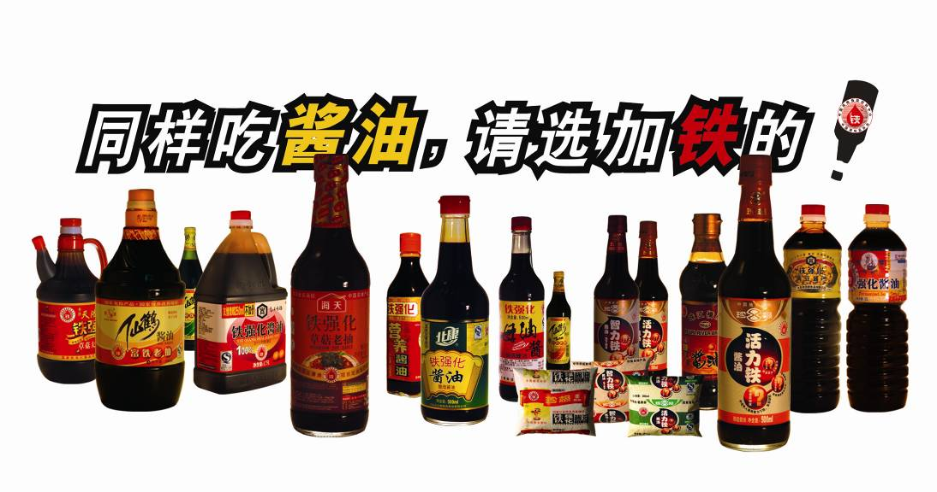
Iron fortified soy sauce: product development Annual output reached 93,000 MT
110 products produced by 22 producers marketed,
Based on grades of soy sauce：
Grade 1 – 23 products;
Grade 2 – 14 products；
Grade 3 – 66 products;
Special grade – 7 products.
Based on types of packaging：
Bottle – 56 products；
Soft bag – 27 products；
Barrel – 27 products。
Price ~ 10% higher than regular products
Notes:
24

Slide 25
Production volume of fortified soy sauce
22 producers joined after training and improvement, Zhen Ji Group at Hebei province designated as a iron fortified soy sauce production base.

Slide 26
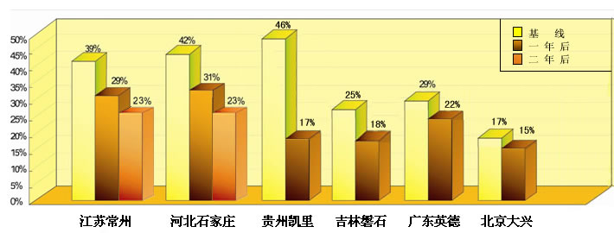
IDA prevalence significantly decreased (women)
Consumer coverage
59.35 million Chinese residents use fortified soy sauce, including 39.87 million of at-risk population
Baseline
After 1 yr
After 2 yrs
80% of at-risk population aware of the health benefits of iron fortified soy sauce
Notes:
26

Slide 27
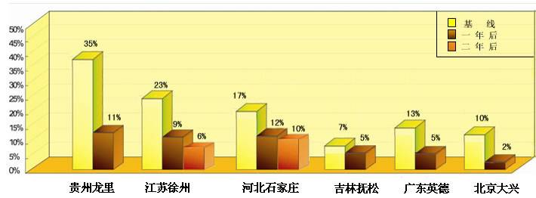
Anemia prevalence in the at-risk population reduced 30% or more in 7 provinces (sentinel data)
Baseline
After 1 yr
After 2 yrs
Notes:
27

Slide 28
2. Nutrient-dense food supplement (YYB)
for complementary feedng

Slide 29
Reduction of anemia prevalence
Reducing the rate of children anemia by using Fortified food supplement
Reduce 47％ for using 6 months
%

Slide 30
Sustained Intelligence development of children supplemented with fortified food supplement
FFS NFFS Control
Supplement food added to CF during 6-24 month of age.
IQ Test done after completion of supplementation at age 3-4,4-5,5-6 years old

Slide 31
Ongoing activities on the application of nutrient-dense supplement food (YYB) in China(1)
Activity | Settings | Institution | Effectiveness
Earthquake areas | Li xian Children 6-24 months | China CDC,Unicef, Gain Company: Bailemai | Since 2008 Sept. Anemia % from 71.8% reduced to 31.9% in 1.5 years
Prevention Program | 8 earthquake counties in 3 province Children 6-24 months | MOH, Unicef, China CDC Companies: Bailemai, | Since 2010 June
Extension Program | 12 provinces 23,000 children 6-24 mionths | MOST, China CDC Companies: | Since 2010 April Established distribution mechanism

Slide 32
Ongoing activities on the application of nutrient-dense supplement food (YYB) in China(2)
Activities | Settings | Institutions | Effectiveness
Social Equity Project- policy research | 2 counties in 2 provinces（ （Qinghai & Yunnan ）Province a. 6-24 months children YYB daily b. multi nutrients supplements for pregnant women | CDRF, China CDC , ILSI-FP China Company: 1. DSM for YYB. 2. Shiji Weita for supplements for pregnant women | Since 2009 Sept.in 12 months: a. Anemia reduction from 66% to 38.7% b. Stunting % of children aged <18 month reduced c. Diarrhea and fever incidence reduced d. % of LBW halved

Slide 33
3. Fortified wheat flour in shanxi

Slide 34
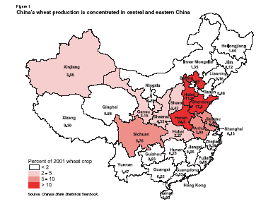
Flour fortification
1993-2000：RETA Project ，Science and feasibility study of flour fortification
2000-2002：Technology study of flour fortification in Chin。
2003-2008：Wheat fortification in Reforest compensation program: Dingxi project
Wheat flor fortification in high NTD prevalence counties in Shanxi
Current discussion on regional wheat flour fortification
The colored part in the figure are the major wheat consumption provinces in Mainland China, among them, Henan, Hebei and Shandong are the provinces with biggest production and consumption.

Slide 35
1. NTD incidence in relation to the consumption of fortified wheat of women in a county (with 9132 child-bearing age women involved) in Shanxi( n=846)
食用量 | % | Live birth |  | NTD Incidence（‰）
 |  | Normal | NTD
<1000g/m （<33g/day) FA*<22ug/day | 6.8 | 53 | 5 | 86.2
1000g/m~ (33-116g/day) FA 23-78ug/day | 31.8 | 266 | 3 | 11.2
3500g/m~ (117-233g/day) FA 79-157ug/day | 16.8 | 141 | 1 | 7.04
>7000g/m (>234g/day) FA >158ug /day | 44.6 | 376 | 1 | 2.65
Total | 100.0 | 836 | 10 | 11.8
* FA=folic acid, calculated by folic acid fortified in the wheat flour

Slide 36
2. Nutrient enrichment in wheat flour in Hebei and Gansu Province
Notes:
36
36

Slide 37
Applied in 2211 rural households in 2 villages for 3 years (2003-2006)
Status of micronutrient deficiencies improved:
Iron deficiency reduced in terms of biological assessment
Serum folic acid and zinc level improved
Marginal vit. A deficiency reduced from 31.9% to 3.7% in Weichang and from 12.1% to 2.2% in Lanzhou.

Slide 38
4. Application of comprehensive food fortification in school

Slide 39
FFO of China CDC applied comprehensive food fortification interventions in PuGongYing Middle school in 2007
Using fortified soy sauce and VA fortified vegetable oil for cooking, and
consuming fortified rice among 500 students for 8 months:
1.Anemia Prevalence reduced to the average of the same area (see fig);
2. Marginal VA def. reduced from 15.4% to 6.4% .
Notes:
39

Slide 40
Cost for comprehensive intervention
 | Cost increased （Yuan/day)
 | Boys | Girls
Fortified so sauce | 0.0015 | 0.0015
VA fortified veg. oil | 0.015 | 0.015
Multi-nutrients fort. rice | 0.06 | 0.03
Eggs | 0.21 | 0.21
Total cost | 0.29 | 0.26

Slide 41
5. Technology for rice fortification is matured
Notes:
41

Slide 42
Appeal for partnership
Government –
Policy, regulation & standards, advocacy, sectoral coordination
Scientists –
Research, product evaluation, information,
public education, assist social marketing
Industry --
R&D, production,distribution, price, safety,
social responsibility, social marketing
No partnership among them,
no success of national program.

Slide 43
Looking into the future
The activities are supported by the governmental sectors such as MOH, National Grain Bureau, and local governments;
But still are at project basis and societal experiment level;
We are on the way of scaling up – Policy making, industry commitments to social responsibility on massive fortification, intensive and effective public education on the health and development benefits of fortified food are the requisites for scaling up.;
We fell confident ,
but there is a long way to go!

Slide 44
Thank you!

